Slide 1
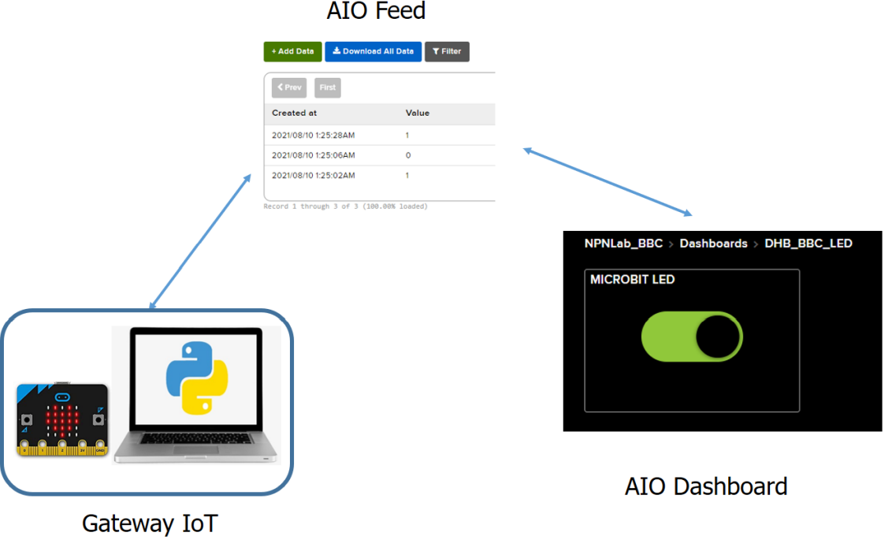
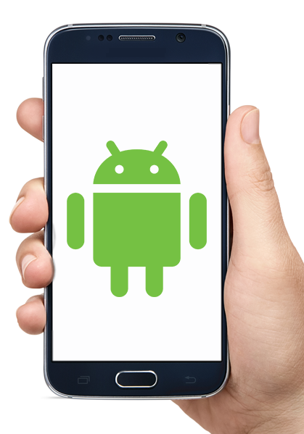
Assignment Project Internet of Things Applications

Slide 2
Basic Requirements (8 points)
Integrate all the LABs: MQTT with Adafruit IO, AI inference using Google Teachable Machine and Mobile App
Interface with hardware platforms:
CS: Any microcontroller platform (Arduino, Yolobit, v.v…)
CE: Must use the STM32F103RB, 2 ADC channels are required for the sensors (e.g. soil humidity and light intensity)

Slide 3
1 – Hop Error Controller (1 point)
Implement the Stop and Wait protocol for one hop communication:
MCU and the Python gateway
Python gateway and AIO server
Mobile app and AIO server

Slide 4
2 – Hops Error Controller (2 points)
The message from the mobile app is confirm by the Python gateway

Slide 5
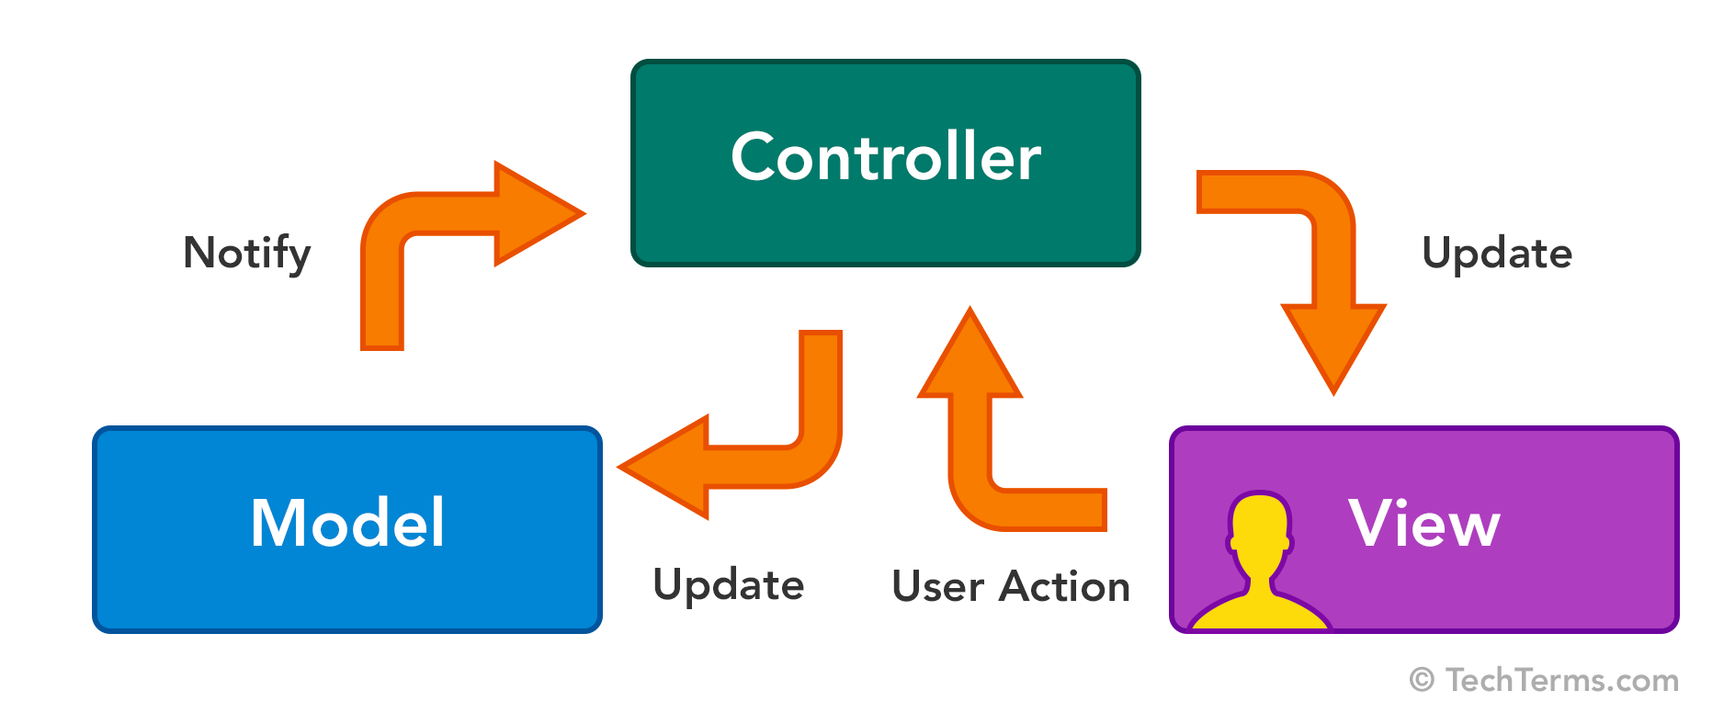
MVC Template (1 point)
Python source code
Android source code

Slide 6
Extra feature (1 point)
Activity using Fragment in Android + Graph UI
Voice activation for controlling device (Speech to Text)
YoloV3 or YoloV5 for the AI Inference
Proposed by students

